Slide 1
Welcome
CS 472/572
Unsupervised Machine Learning
Hierarchical Clustering
Week-6 -Class -1
Spring 2026
Instructor: Dr. Khondker Fariha Hossain

Slide 2
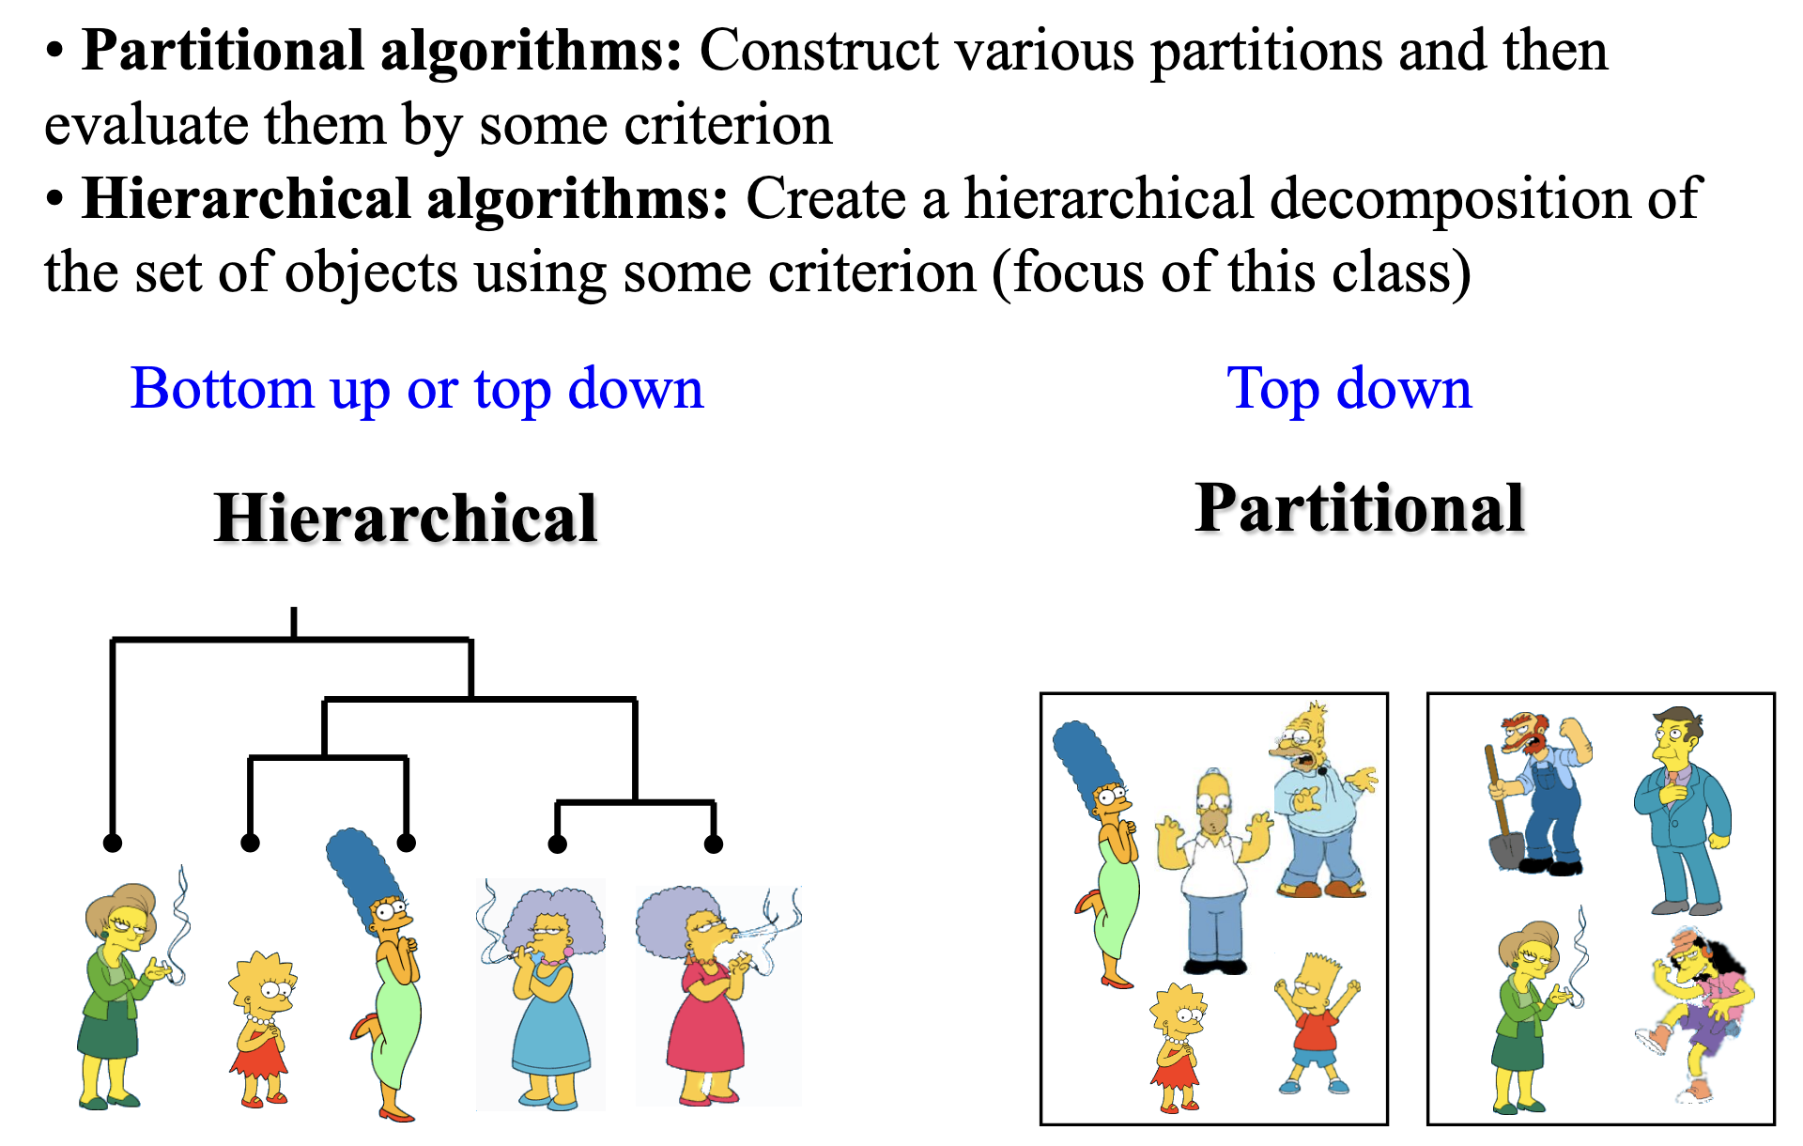


Two Types of Clustering

Slide 3
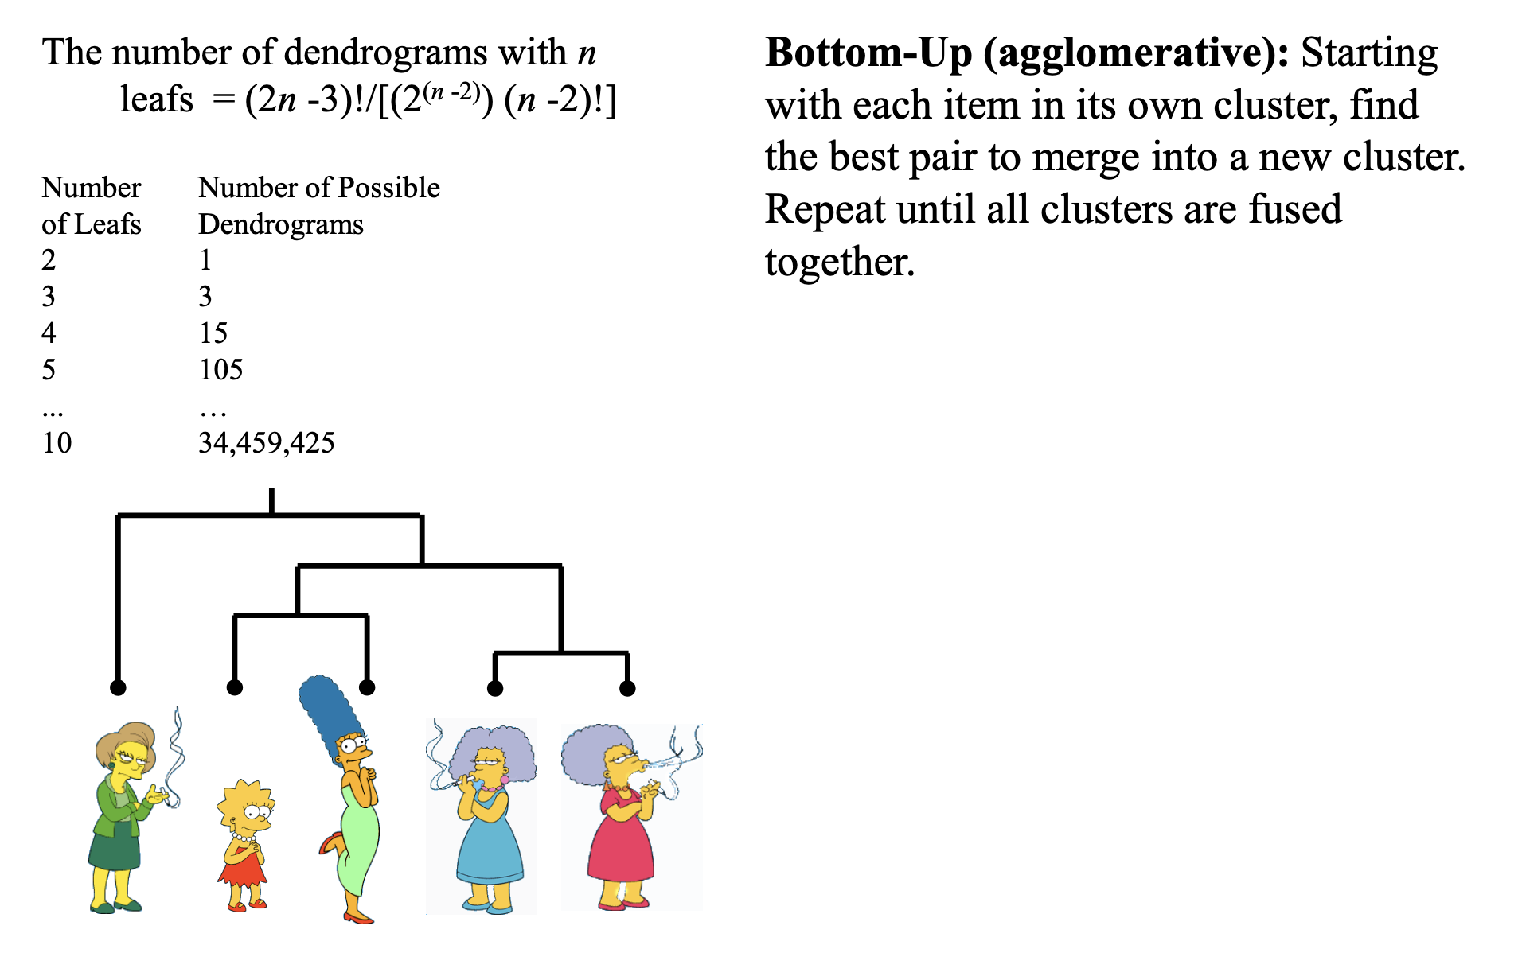
(How-to) Hierarchical Clustering

Slide 4
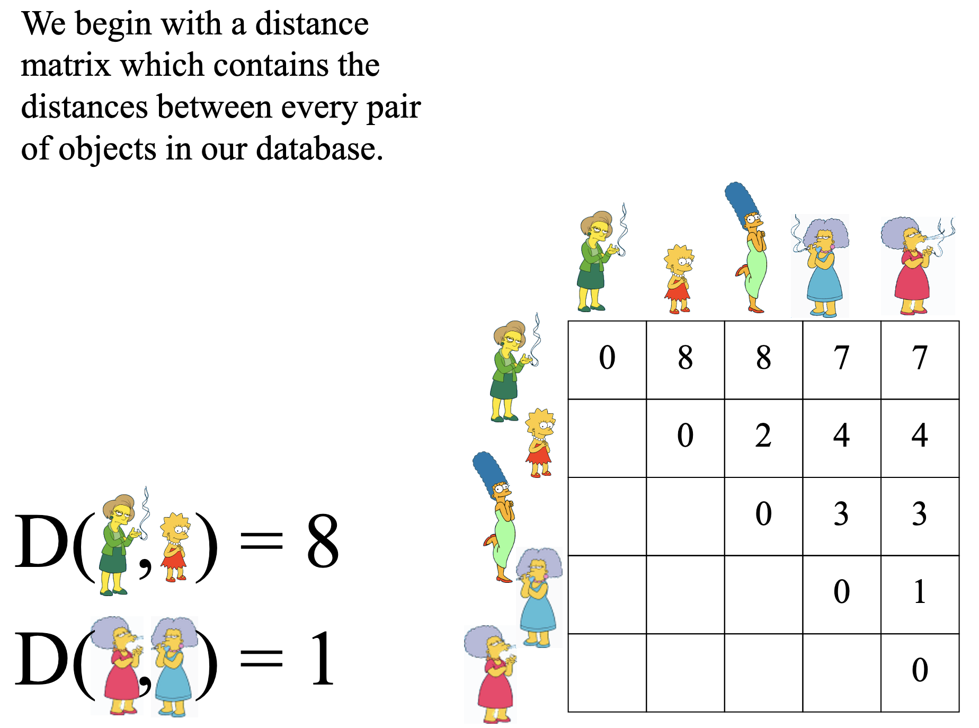
(How-to) Hierarchical Clustering

Slide 5
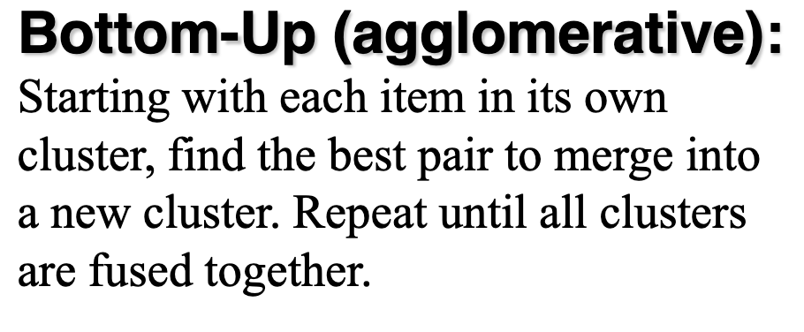
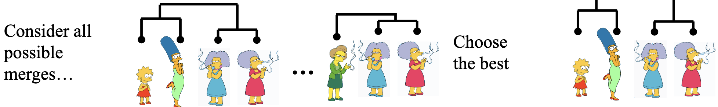
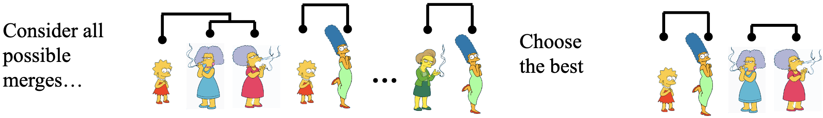
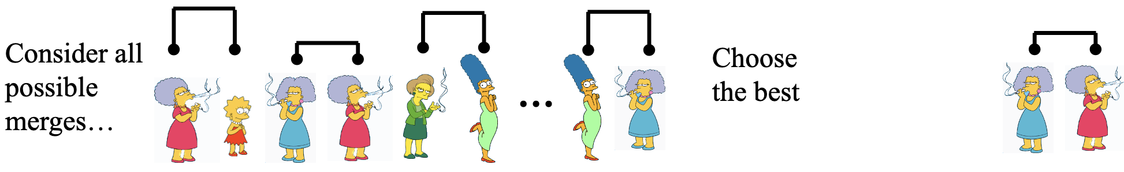
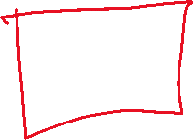
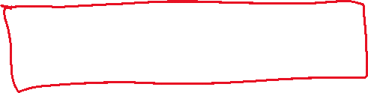


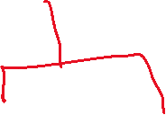
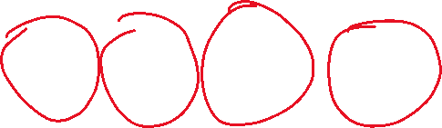
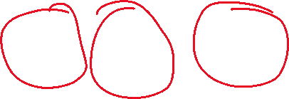
(How-to) Hierarchical Clustering

Slide 6
Technique Characteristics
Hard vs Fuzzy
Hard clustering assigns each instance to one cluster
fuzzy clustering assigns degree of membership
Monothetic vs Polythetic
Polythetic: all attributes are used simultaneously, e.g., to calculate
distance (most algorithms)
Monothetic: attributes are considered one at a time
Incremental vs Non-Incremental
With large data sets it may be necessary to consider only part of the data at a time (data mining)
Incremental works instance by instance

Slide 7
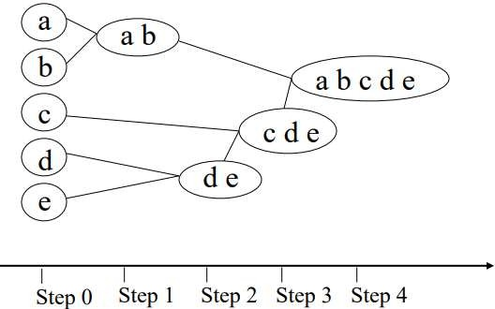
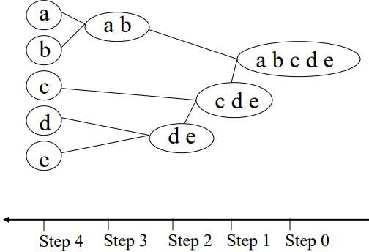
Hierarchical Clustering
A hierarchical clustering is a set of nested clusters that are organized as a tree.
Agglomerative vs Divisive
Agglomerative: each instance is its own cluster and the algorithm merges clusters
Divisive: begins with all instances in one cluster and divides it up
Agglomerative
Divisive

Slide 8
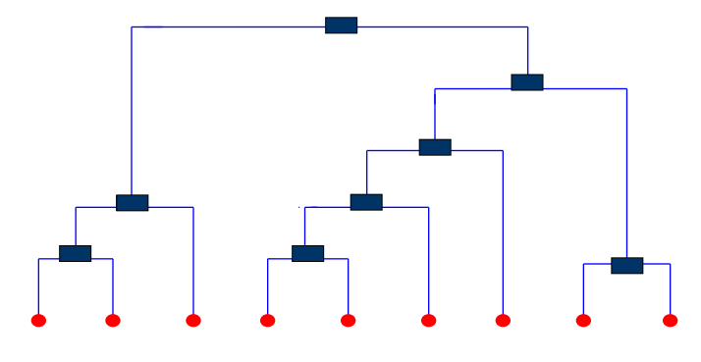

Dendrogram
A tree that shows how clusters are merged/split hierarchically
Each node on the tree is a cluster; each leaf node is a singleton cluster

Slide 9
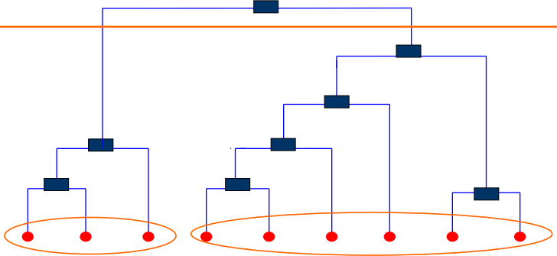
Dendrogram
A clustering of the data objects is obtained by cutting the dendrogram at the desired level, then each connected component forms a cluster

Slide 10
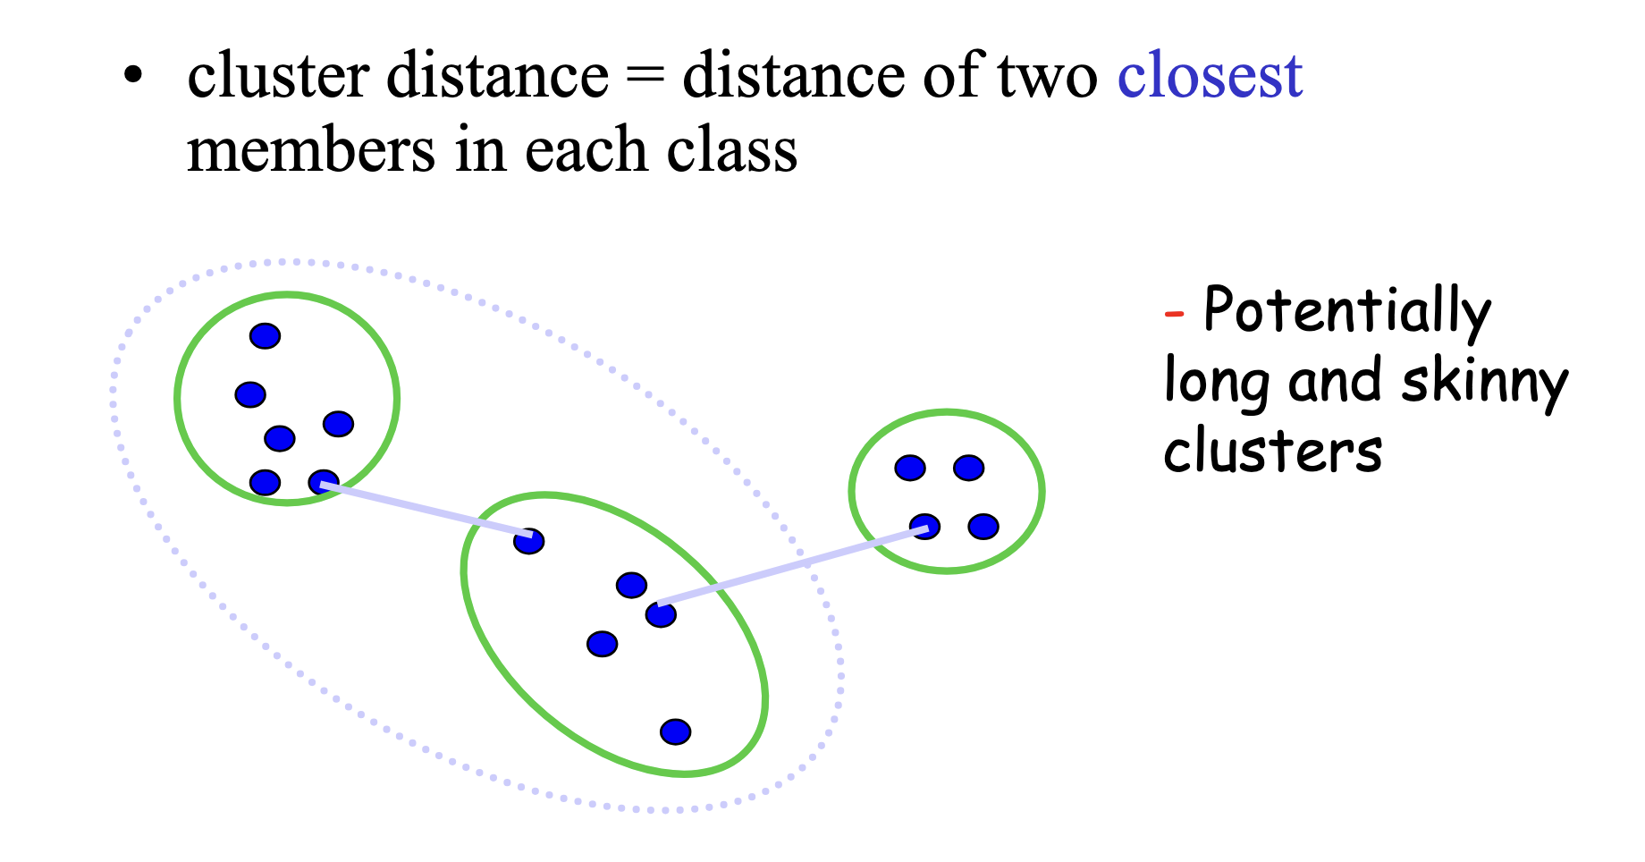


Computing distance between clusters: Single Link

Slide 11
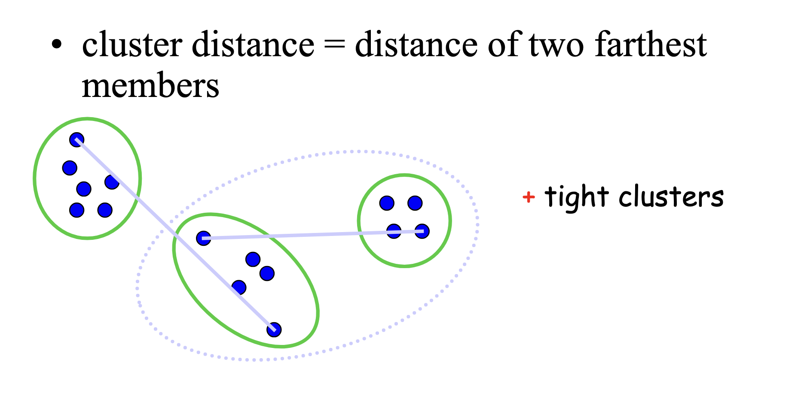

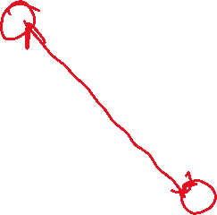
Computing distance between clusters: : Complete Link

Slide 12
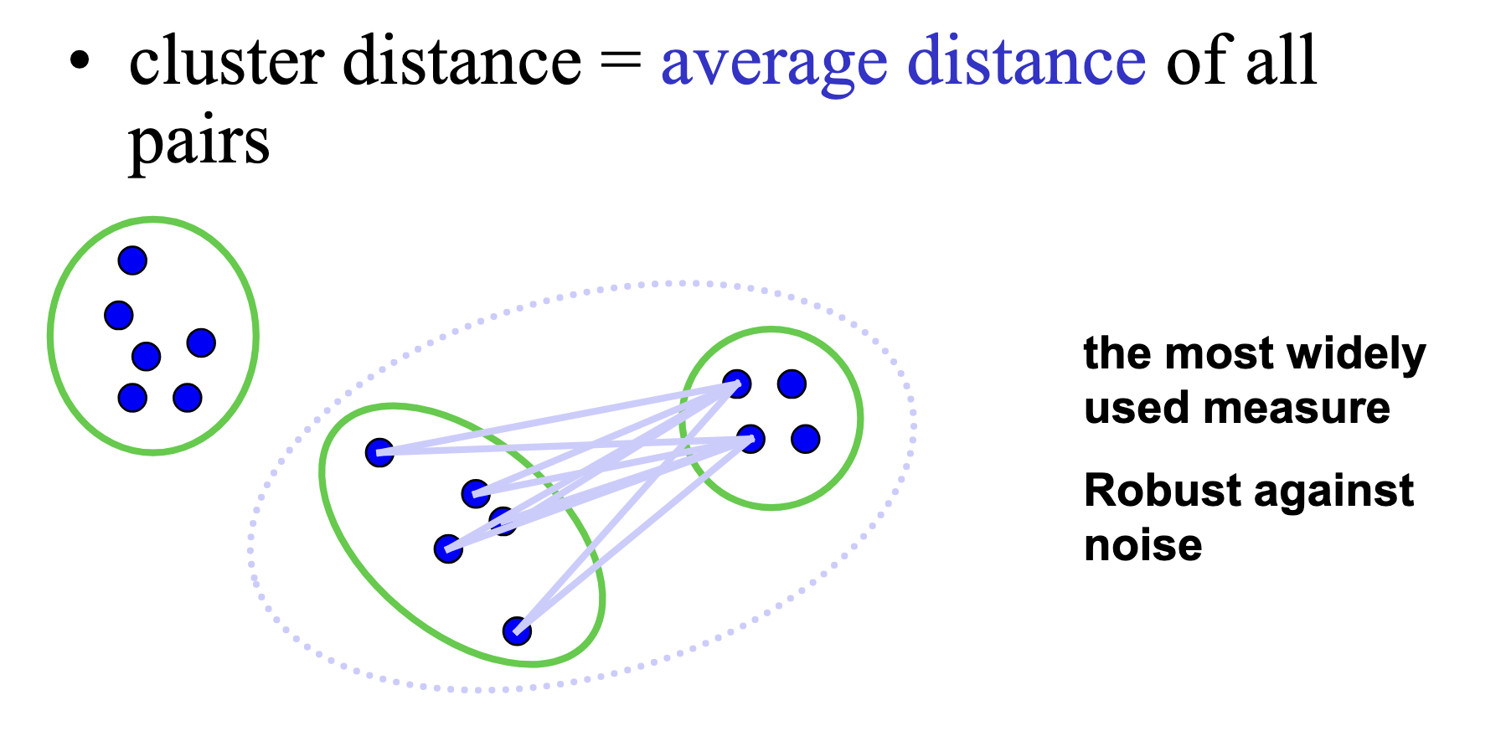
Computing distance between clusters: Average Link

Slide 13
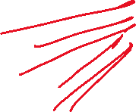
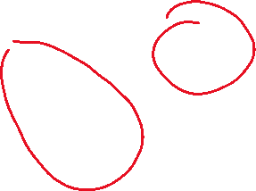
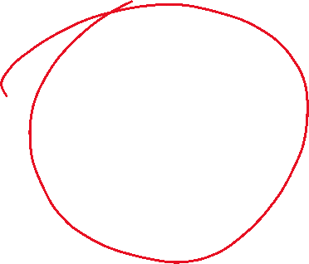
Computing distance between clusters: Average Link

Slide 14
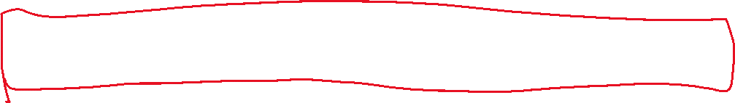
Computing distance between clusters: Average Link
Single Linkage: distance between closest points
Complete Linkage: distance between farthest points
Average Linkage: mean pairwise distance across all points in the two clusters

Slide 15
Computing distance between clusters: Average Link
🔹 Single Linkage (Nearest‑Neighbor Linkage)
What it does:
Measures distance between the closest points in two clusters
Tends to create long, chain‑like clusters (a phenomenon called chaining)
Very sensitive to noise and outliers
Use When:
You want to detect non‑spherical, elongated structures
You care about preserving connectivity even when clusters are oddly shaped
Real‑Life Example:
Detecting road or river networks in satellite images: Single linkage can follow meandering paths and connect points that form long, skinny shapes (e.g., a highway or river).

Slide 16
Computing distance between clusters: Average Link
Complete Linkage (Farthest‑Neighbor Linkage):
What it does:
Measures distance between the farthest points in two clusters
Creates compact, well‑separated, tight clustersLess sensitive to noise, but may break long clusters apart
Use When:
You want compact clusters with clear boundaries
You need to avoid very spread‑out or elongated groups
Real‑Life Example:
Grouping customers for premium-targeting in marketing
Complete linkage ensures each customer in a cluster is similar to all others, giving you high‑quality, tightly defined segments.

Slide 17
Computing distance between clusters: Average Link
Average Linkage (UPGMA: Unweighted Pair Group Method with Arithmetic Mean)
What it does:
Computes the average pairwise distance between all points in two clusters
Provides a balanced compromise between single and complete linkage
Less sensitive to noise than single linkage,less strict than complete linkage
Use When:
You want stable, general‑purpose clustering
You don’t need extreme compactness or sensitivity
Data has moderately well‑defined, but not perfectly spherical clusters
Real‑Life Example:
Clustering documents or articles by topicAverage linkage handles varied writing styles and vocabulary while still grouping documents by general similarity.

Slide 18
Agglomerative Clustering Algorithm
More popular hierarchical clustering technique
Basic algorithm is straightforward
Compute the distance matrix
Let each data point be a cluster
Repeat
Merge the two closest clusters
Update the distance matrix
Until only a single cluster remains
Key operation is the computation of the distance between two clusters
Different approaches to defining the distance between clusters distinguish the different algorithms

Slide 19
Agglomerative Clustering Algorithm
More popular hierarchical clustering technique
Basic algorithm is straightforward
Compute the distance matrix
Let each data point be a cluster
Repeat
Merge the two closest clusters
Update the distance matrix
Until only a single cluster remains
Key operation is the computation of the distance between two clusters
Different approaches to defining the distance between clusters distinguish the different algorithms

Slide 20
Agglomerative Hierarchical Clustering
- Single Linkage

Slide 21
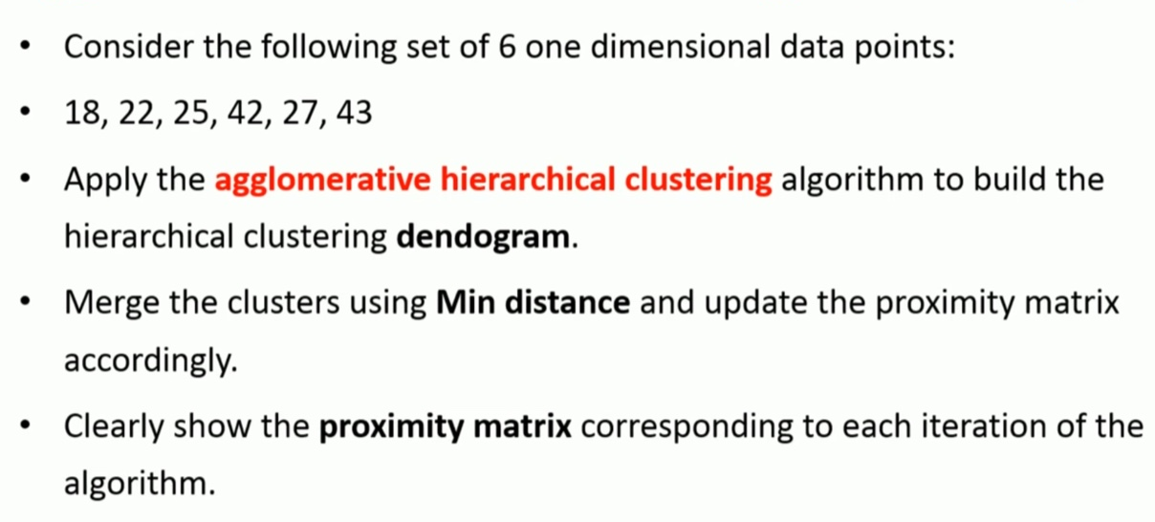
Agglomerative Hierarchical Clustering - Single

Slide 22
Agglomerative Hierarchical Clustering - Single
Step – 1
 | 18 | 22 | 25 | 27 | 42 | 43
18 | 0 | 4 | 7 | 9 | 24 | 25
22 | 4 | 0 | 3 | 5 | 20 | 21
25 | 7 | 3 | 0 | 2 | 17 | 18
27 | 9 | 5 | 2 | 0 | 15 | 16
42 | 24 | 20 | 17 | 15 | 0 | 1
43 | 25 | 21 | 18 | 16 | 1 | 0
Merge: (42, 43)

Slide 23
Agglomerative Hierarchical Clustering - Single
Step – 2
 | 18 | 22 | 25 | 27 | 42, 43
18 | 0 | 4 | 7 | 9 | 24
22 | 4 | 0 | 3 | 5 | 20
25 | 7 | 3 | 0 | 2 | 17
27 | 9 | 5 | 2 | 0 | 15
42, 43 | 24 | 20 | 17 | 15 | 0
Merge: (42,43)(25, 27)

Slide 24




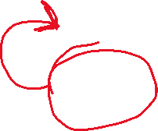

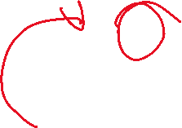





Agglomerative Hierarchical Clustering - Single
Step – 3
 | 18 | 22 | 25, 27 | 42, 43
18 | 0 | 4 | 7 | 24
22 | 4 | 0 | 3 | 20
25, 27 | 7 | 3 | 0 | 15
42, 43 | 24 | 20 | 15 | 0
Merge: ((42,43)(25, 27), 22)

Slide 25





Agglomerative Hierarchical Clustering - Single
Step – 4
 | 18 | 22, 25, 27 | 42, 43
18 | 0 | 4 | 24
22, 25, 27 | 4 | 0 | 15
42, 43 | 24 | 15 | 0

Slide 26
Agglomerative Hierarchical Clustering - Single
Step – 5
 | 18, 22, 25, 27 | 42, 43
18, 22, 25, 27 | 0 | 15
42, 43 | 15 | 0
Merge: ((18,22,25,27), (42,43))

Slide 27
Agglomerative Hierarchical Clustering - Single
Step – 6
 | 18, 22, 25, 27, 42, 43
18, 22, 25, 27, 42, 43 | 0

Slide 28
Agglomerative Hierarchical Clustering - Single
Step – 5
 | 18, 22, 25, 27, | 42, 43
18, 22, 25, 27 | 0 | 15
42, 43 | 15 | 0
Merge: ((42,43),((25,27),22), 18)

Slide 29
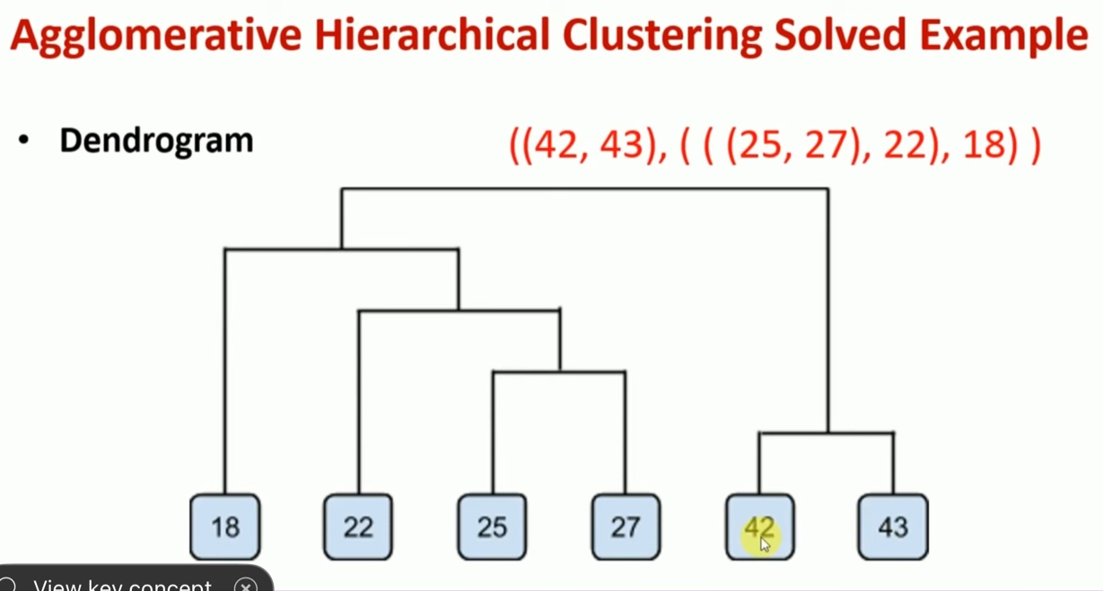

Agglomerative Hierarchical Clustering - Single

Slide 30
Agglomerative Hierarchical Clustering
– Complete Linkage

Slide 31
Agglomerative Hierarchical Clustering – Complete Linkage
•Given a one dimensional Dataset: {1, 5, 8, 10, 2}, use the agglomerative clustering with the complex link with Euclidian distance to establish a hierarchical grouping relationship.
By using the cutting threshold of 5, how many clusters are there?

Slide 32
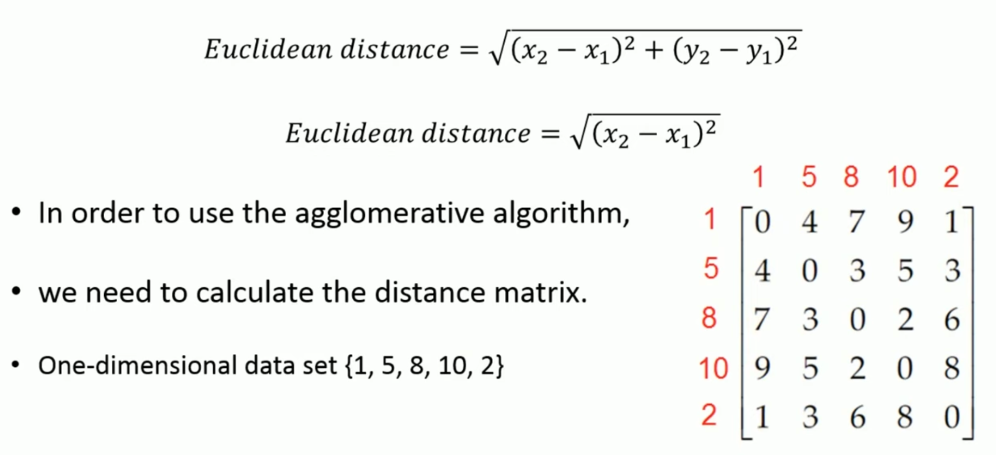


Agglomerative Hierarchical Clustering – Complete Linkage

Slide 33
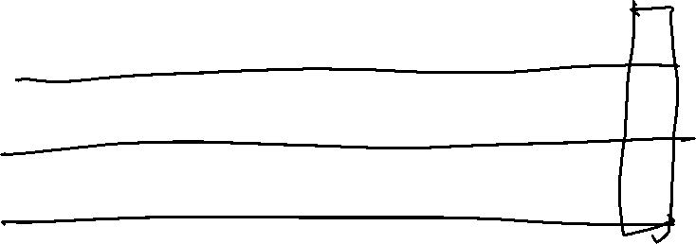

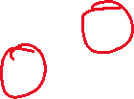


Agglomerative Hierarchical Clustering – Complete Linkage
 | 1 | 2 | 3 | 4 | 5
1 | 0 | 4 | 7 | 9 | 1
2 | 4 | 0 | 3 | 5 | 3
3 | 7 | 3 | 0 | 2 | 6
4 | 9 | 5 | 2 | 0 | 8
5 | 1 | 3 | 6 | 8 | 0
• d(2, {1,5}) = max{ d(2,1), d(2,5) } = max {4, 3} = 4
• d(3, {1,5}) = max{ d(3,1), d(3,5) } = max {7, 6} = 7
• d(4, {1,5}) = max{ d(4,1), d(4,5) } = max {9, 8} = 9
• Let the 1st column (row) denote the distances
between this cluster and other points,
we have the following distance matrix:
 | 1,5 | 2 | 3 | 4
1,5 | 0 | 4 | 7 | 9
2 | 4 | 0 | 3 | 5
3 | 7 | 3 | 0 | 2
4 | 9 | 5 | 2 | 0

Slide 34


Agglomerative Hierarchical Clustering – Complete Linkage
 | 1,5 | 2 | 3 | 4
1,5 | 0 | 4 | 7 | 9
2 | 4 | 0 | 3 | 5
3 | 7 | 3 | 0 | 2
4 | 9 | 5 | 2 | 0
• From the above distance matrix, we can see the distance between points 3 and 4 is smallest.
• Hence, they merge together to form a cluster {3, 4}.
• Using the complete link, we have the distance between different points/clusters as follows:
• d({1,5}, {3,4}) = max{ d({1,5}, 3), d({1,5}, 4) } = max{ 7, 9 } = 9
• d(2, {3,4}) = max{ d(2,3), d(2,4) } = max{ 3, 5 } = 5
• Thus, we can update the distance matrix,
where row 2 corresponds to point 2, rows 1 and 3
correspond to clusters {1,5} and {3,4}, as follows:
 | 1,5 | 2 | 3,4
1,5 | 0 | 4 | 9
2 | 4 | 0 | 5
3,4 | 9 | 5 | 0

Slide 35
Agglomerative Hierarchical Clustering – Complete Linkage
 | 1,5 | 2 | 3,4
1,5 | 0 | 4 | 9
2 | 4 | 0 | 5
3,4 | 9 | 5 | 0
Following the same procedure, we merge point 2 with the cluster {1, 5} to form {1,2,5} and update the distance matrix as follows:.
 | [1,5],2 | [3,4]
[1,5], 2 | 0 | 9
[3,4] | 9 | 0
After increasing the distance threshold to 9, all clusters would merge

Slide 36
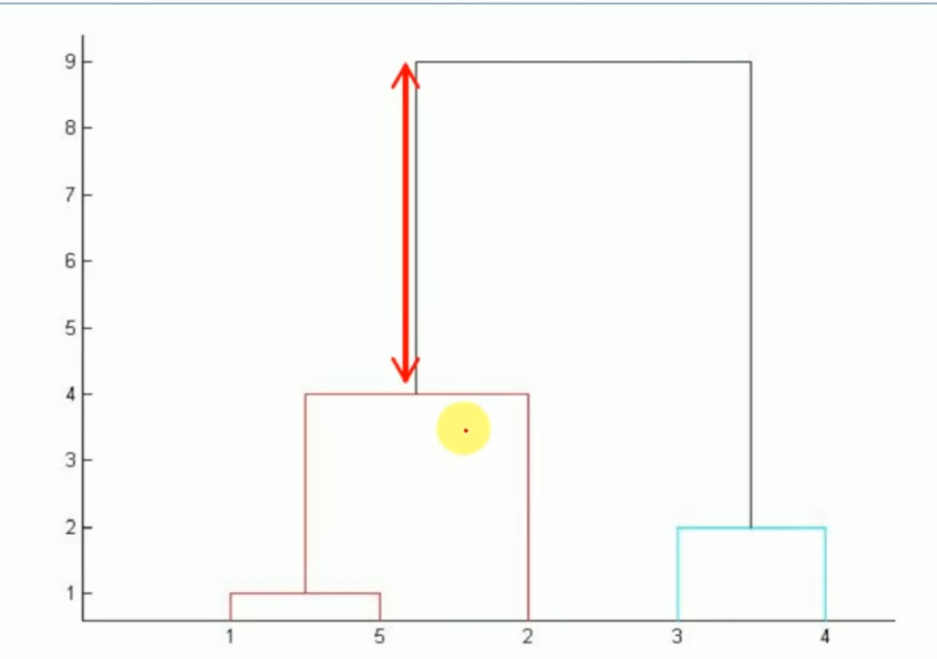
Agglomerative Hierarchical Clustering – Complete Linkage

Slide 37
Thank You
Reference:
CMU : 10601- Machine learning
Hierarchical Clustering – Mahesh Huddar

